Slide 1

Embedded Part
Arm
Box
Base Moving

Slide 2
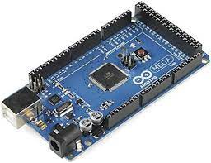

Main Part
Microcontroller Mega:
We using this micro controller for many reasons like
More digital and analog inputs/outputs, and more processing power than other microcontroller boards
Suitable for more complex projects or applications.

Slide 3
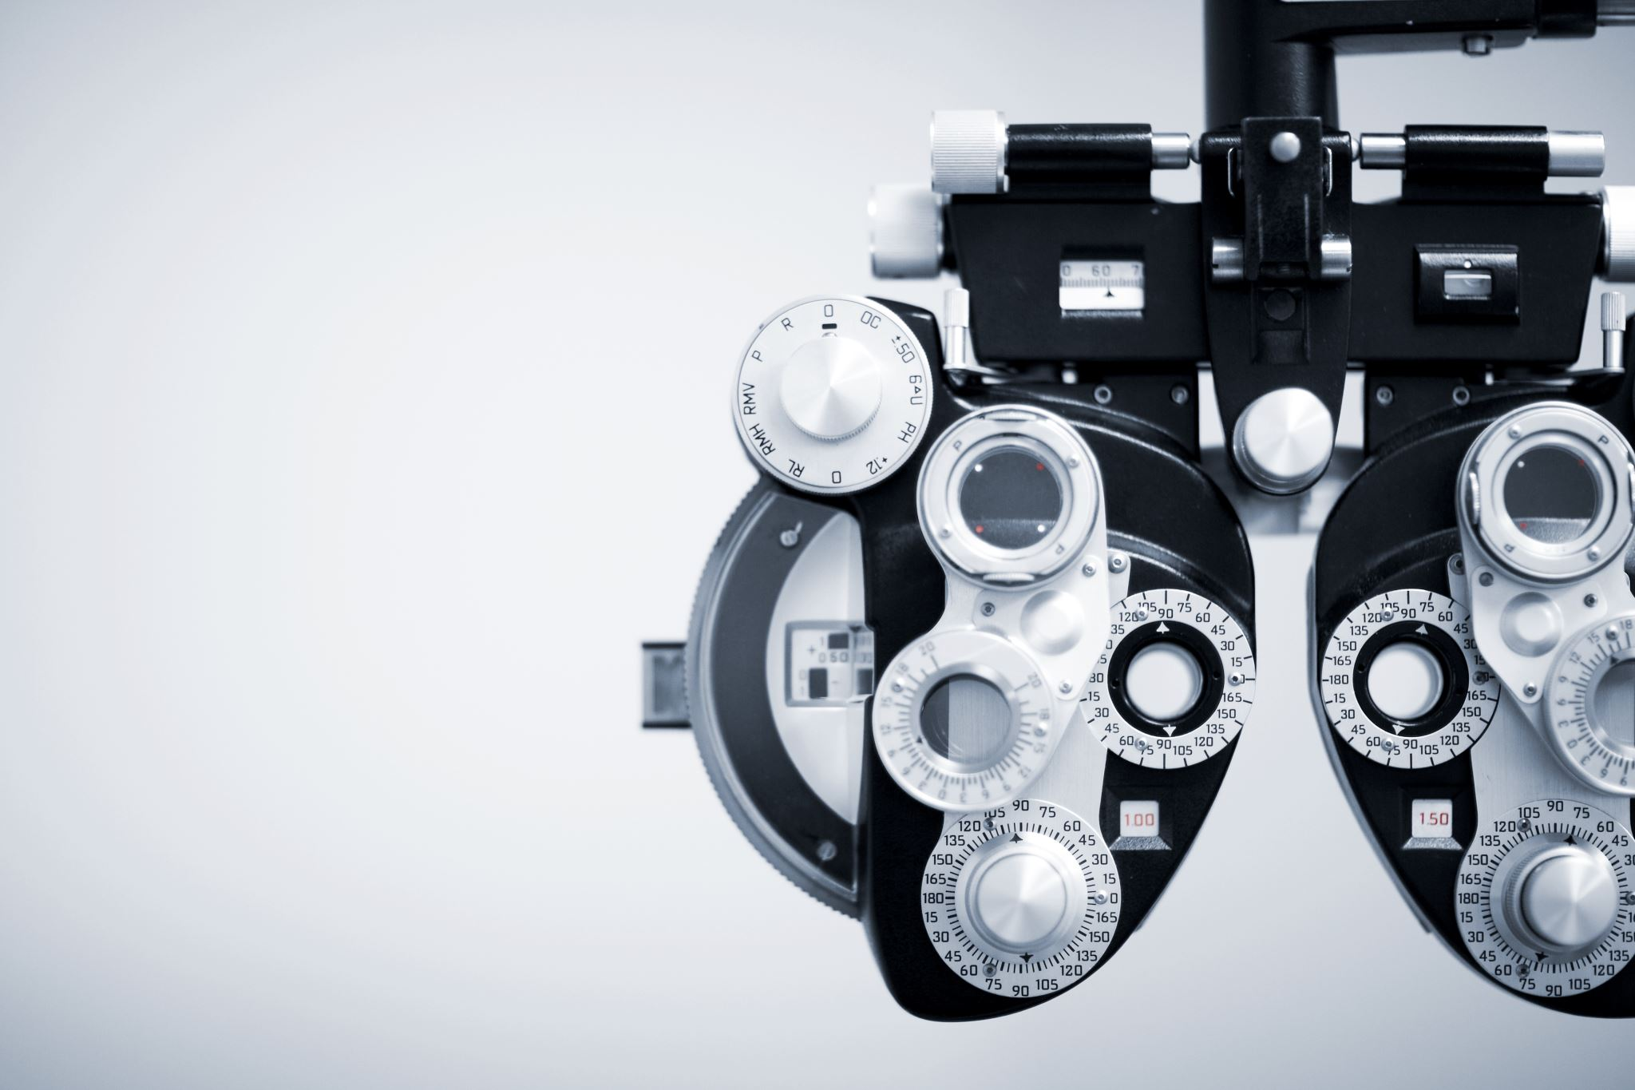
Arm
MLX90614 sensor
MAX30102 sensor

Slide 4
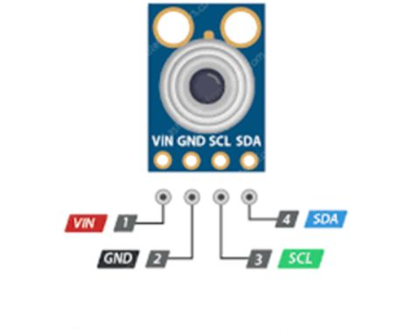
MLX90614 sensor
sense temperature(Main)
Accuracy: ±0.5°C
Resolution: ±0.2°C
Distance between object and sensor: 2cm-5cm

Slide 5
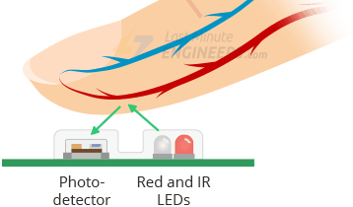
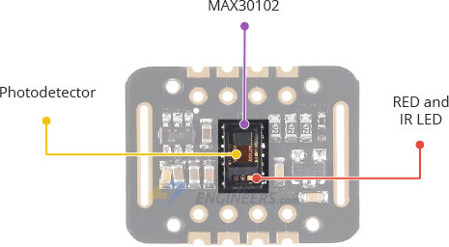
MAX30102 sensor
Sensing:
SPO2
Heart Rate
Reading Temperature (Spare using)

Slide 6

Box
3 IR sensor:
we using IR cuz its cheep and
This box will be self open from patient

Slide 7
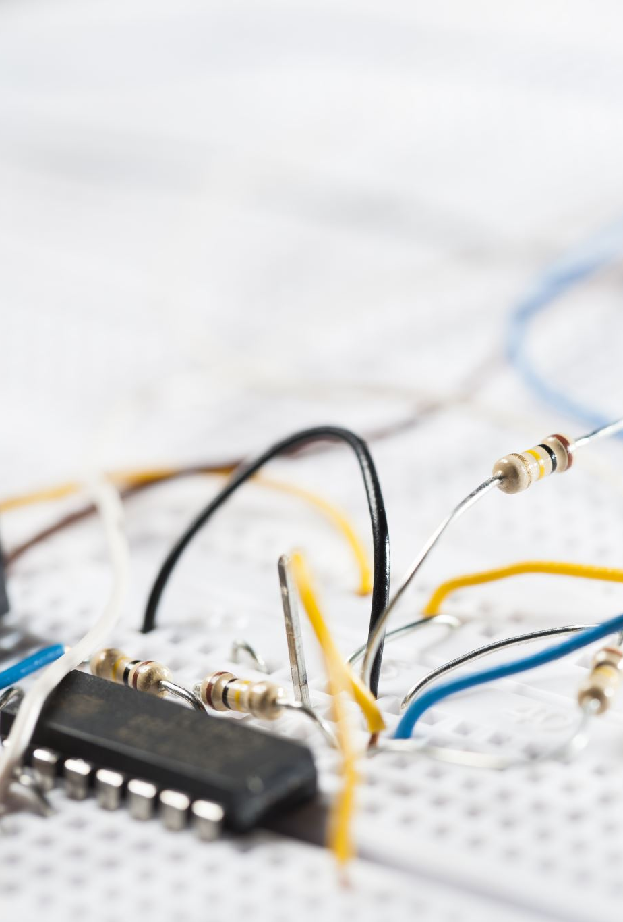
Base: Line follower
We using line tracking lower sensor with
We using this method because we know the path
And reduce cost for not using AI
Line follower based on IR sensor consists of photo transistor
& Diode (LED)

Slide 8
Base: Motion of Robot
Consists of 4 DC motor & motor driver
Each 2 DC separated
Functions of Mottion is :
Forward
Backward
Left
Right

Slide 9
Showing
We will use LCD 4*16 to show functions to the patient
Buzzer: to be alarm to patient to remember him taking medicine

